Slide 1






Blackbox Variational Inference
Fixed form
We need to solve:
We assume q is analytical available so we will investigate two methods for getting the gradients of p:
The score function estimator
The Pathwise gradient estimator

Slide 2

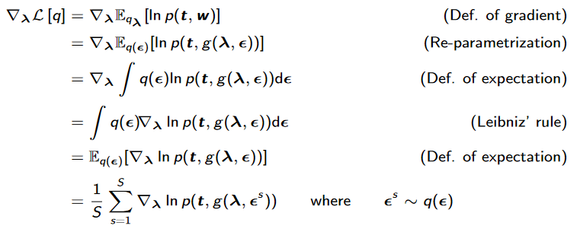



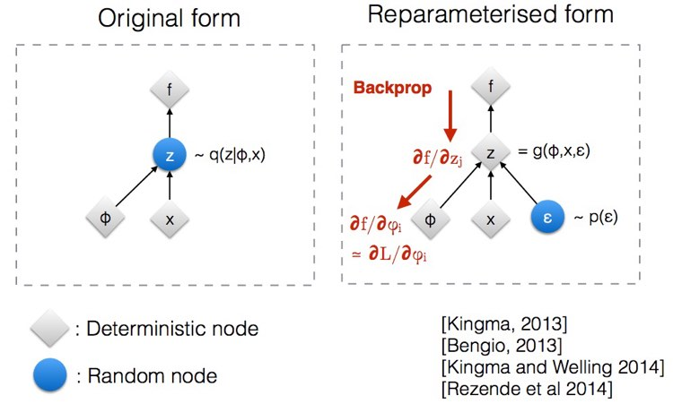
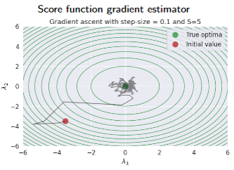
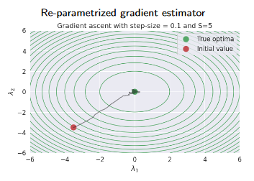
Gradient Sampling
The score function estimator
The pathwise estimator
e.g.

Slide 3
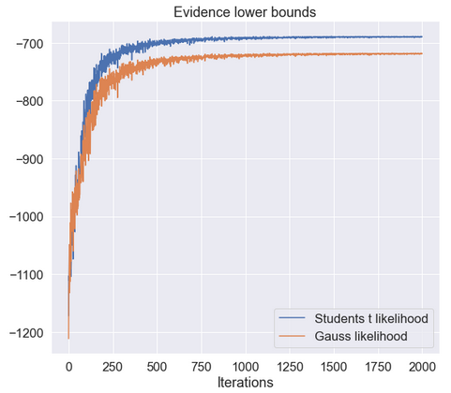
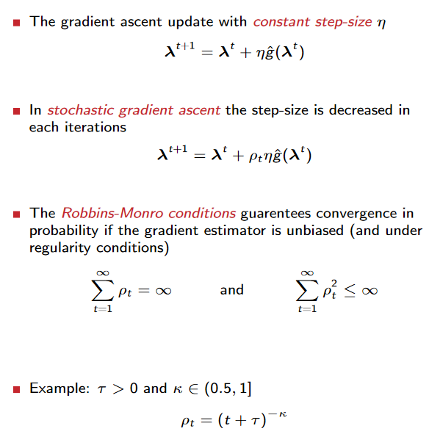
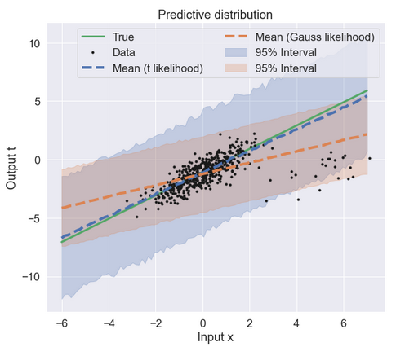
Stochastic Optimization

